Slide 1
Microgrid: Grid Tied and Off Grid Applications

Slide 2
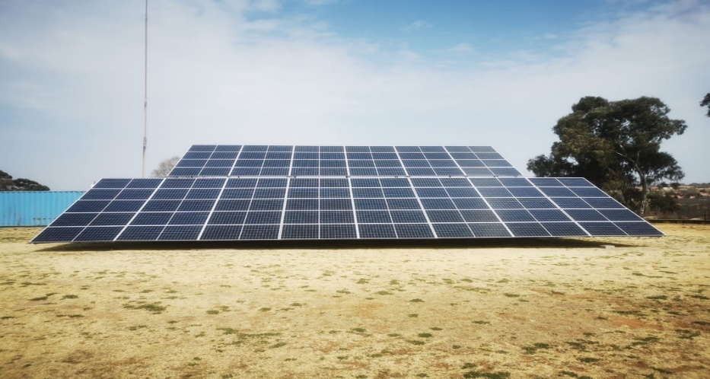
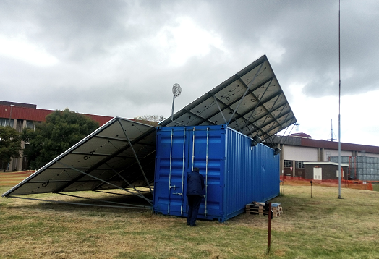
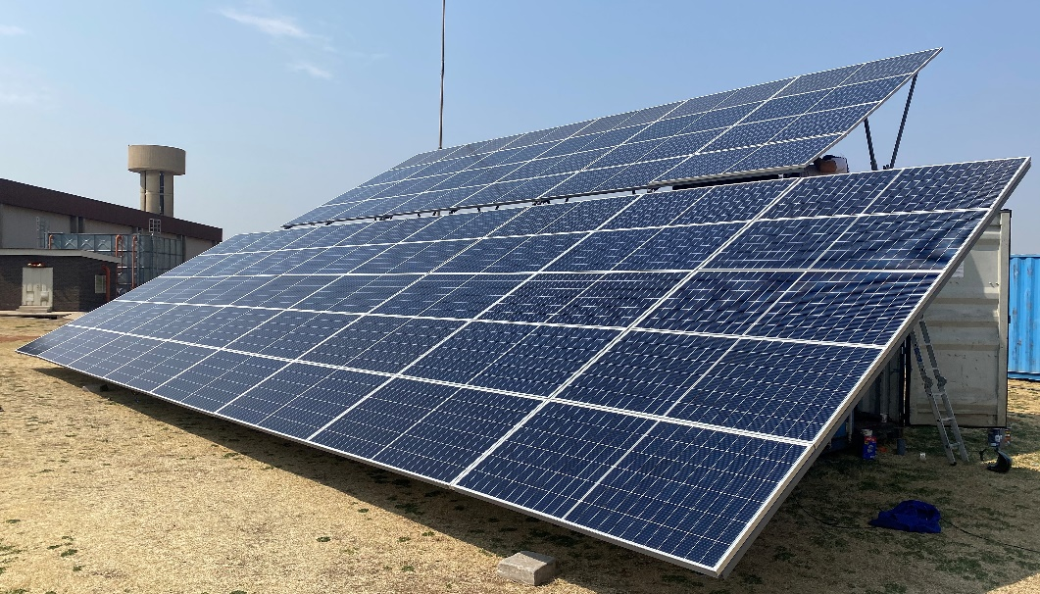
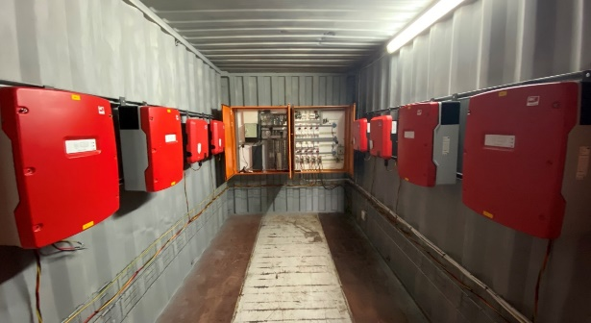
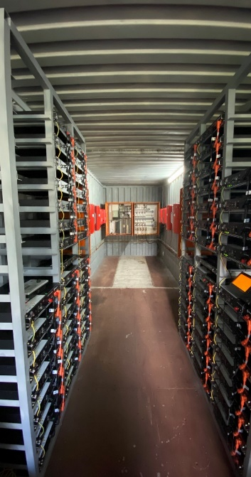
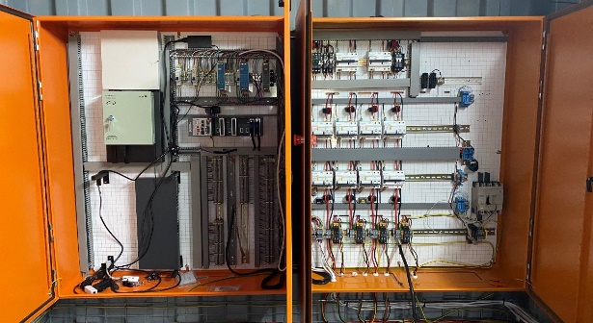
Microgrid: Grid Tied and Off-Grid applications
Deployment Strategy
System Flexibility & Resilience
Research & Innovation
Strict Adherence to technical specification and standards for each system component conforming to Eskom engineering specifications and national standards(NRS).
Administration of an off-grid cost reflective tariff in line with new legislative regarding Distributed generation.
Strategic sourcing of system components to adherence to recommended system costing and specification. Leveraging SD&L and SMME & Public Private participation to bridge the skills gap whilst stimulating economic growth in the sector
Leverage INEP funding and other funding mechanisms to categorise early deployment areas to accelerate the electrification rate.
De-risk the initiative by leveraging SPV models to lower overnight costs and enhancing installations ops and maintenance.
Formulate Training and up-skilling of staff in both the private and public sector to catalyze technology adoption and installation rates.
Establish system visibility and Integrate operations, maintenance and monitoring to legacy systems in a secure IT/OT environment(Future Smart Grid State).
The Microgrid system offers a high degree of configurability ,suited for different scenarios that can assist with offering network Resilience and system flexibility by managing load imbalances. and voltage rise a fall and other fluctuations on the grid.
Individual system components such as Generation, storage and control can be customised to meet a specific network or customer need.
Distributed Energy controllers facilitate automatic supply and demand
A highly skilled team on Eskom Engineers have leveraged the Demonstration and Pilots portfolio with Eskom Research Testing and Development to execute Pilot projects within this area of Specialisation.
All knowledge gained and lessons from these demonstration Pilots will be leveraged for further improvements on new products and services beyond the new energy landscape ,looking into the next horizon technologies such as Fuel-Cells, Solid state battery and storage technologies.
The future customer domain and distributed generation are areas of focus, followed by digitalization and other trends that are leading us to the 4th Industrial revolution.
Contact:
Designed Commissioned and Manufactured by:
Eskom Research Testing and Development
Smart Grid CoE
Nick Singh Tel 0834156235
Singhnn@Eskom.co.za
Figure 4 – 12m Containerised power plant
Figure 6 – 24Kw installed PV Panelsc
Figure 7 – Control & Communication Systems and Lithium Ion battery banks

Slide 3
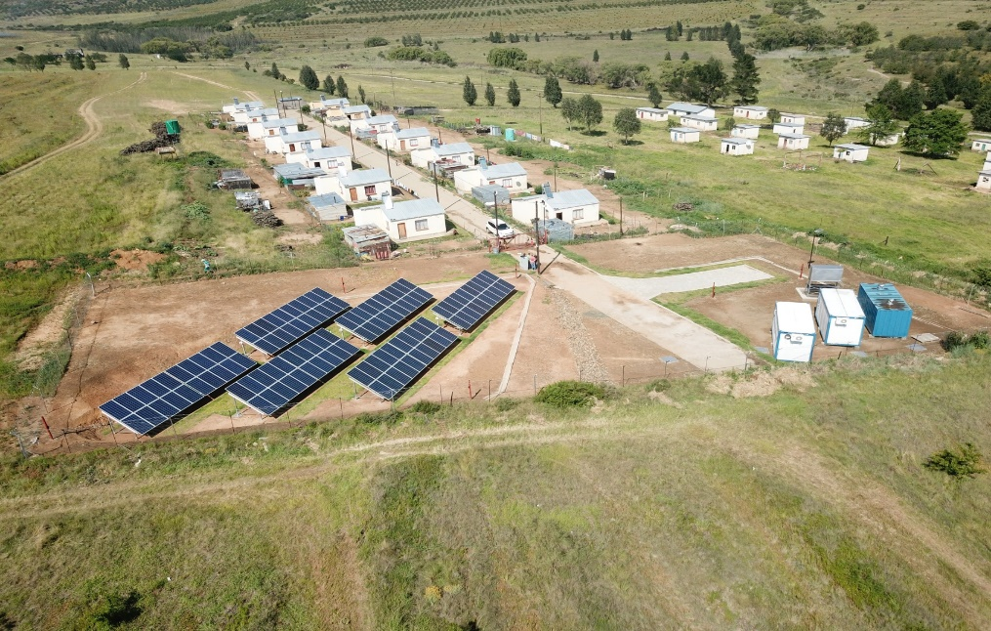
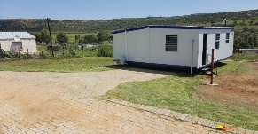
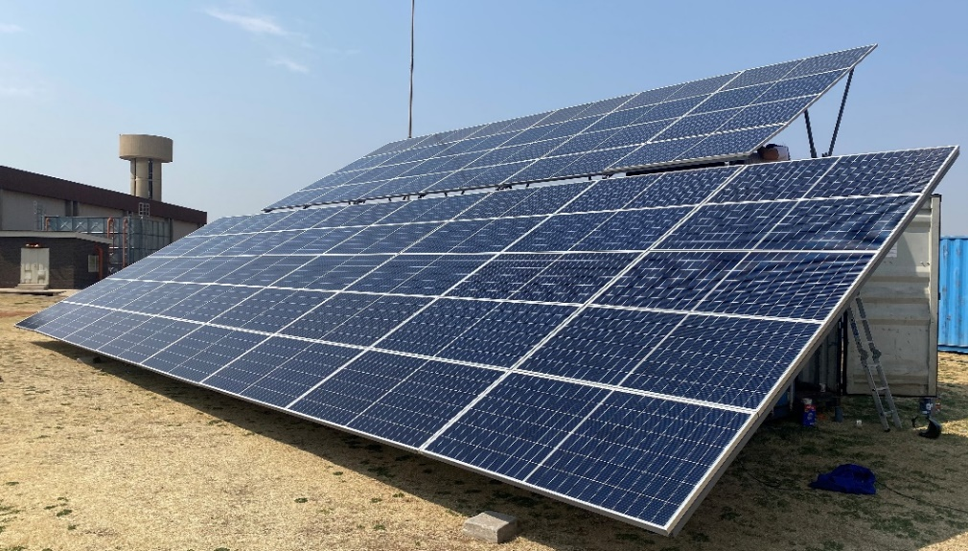
Microgrid: Grid Tied and Off grid applications
Carbon Reduction
Initiative Name
Microgrids(DER)
Potential Benefits
(* reduction are cumulative)
Potential & Opportunities of Microgrids
Installed Capacity | 100MW | 300MW | 500MW | 500MW
CO2 Reduction /year (% of 19/20 base) | 0.03% | 0.11% | 0.24% | 0.37%
Total CO2 reduction Tonnes | 592,22 | 2 955,17 | 8 847,80 | 20 603,68
Universal Access to Electricity by deploying modular containerised off-grid renewable power plants in outlying areas. Schools , small villages and medical clinics.
Grid tied solutions to defer capital investment incurred in building or strengthening existing infrastructure.
Zero emission technology i.e. Over 60 Tons of Carbon Emission has been avoided thus far, being commissioned in Aug 2017, whereas conventional methods of Cooking and heating using Wood and paraffin would have created an equivalent value of emissions. No water is used in the production of energy.
Social Access and upliftment are key imperatives from Eskom JET, and this can also be achieved with microgrid deployment. A number of small business such as chicken farms and food preparation etc. have formed after access to electricity.
Local residence form part of scheduled maintenance to maintain serviceable items such as the cleaning of the solar panels and vegetation management.
The community has been trained on energy utilsation and form an active part of communication link
From a product manufacturing and supply chain perspective, local manufacturing, production and assembly of all the components of the MicroGrid system can stimulate the local economy and create job opportunities as well as up-skilling of the public in this new area of technology deployment.
Category
Emission Reduction & Universal Energy Access ;Renewables
Background & Description
The RT&D Microgrid Pilot in Ficksburg (Fig 1) has successfully demonstrated in an operational live community that a cleaner electrification alternative to traditional grid supplied projects is indeed possible.
Off-Grid Microgrids can provide a greener alternative to electrifying far to reach, isolated communities where the cost of grid extension is too high. Bespoke solutions are also possible for game farms and other niche applications can include end of line grid strengthening and capital deferral.
Optimally balancing the storage and generation capacity with real time load management will achieve highest levels of continuity of supply and subsequent affect on the environmental impact of these technologies.
Over 65 Tons of Carbon Emission has been avoided thus far, being commissioned in Aug 2017, whereas conventional methods of Cooking and heating using Wood and paraffin would have created an equivalent value of emissions.
Social Access and upliftment are key imperatives from Eskom JET, and this can also be achieved with microgrid deployment.
14 Houses
120 residence
Office/
Training Centre
90 kWh Lithium Batteries
32 kWp Solar
Figure 1 - Ficksburg
Technology Overview & Integration
king
The containerised Microgrid System (Fig 2) is optimized to host variable renewable generation technologies such as PV Solar and/or Wind, fuel cells etc.
The control system manages supply and demand conditions in near real-time, with self healing and remote engineering/monitoring capabilities, as well as advanced security, and alarming.
The system is linked to a Control Centre that uses Artificial intelligence and machine Learning to forecast factors that could impact the remote plant such as Fire, weather and irradiation which are directly linked to the plants production.
Each plant creates a communication network with the users that can be leveraged for Internet access, & communications (Education ,Health and social broadcasts and other value added services)
Figure 2 – Containerised Microgrid
Figure 3 –Power inverter Bays

